Slide 1


Harnessing-Data-Analytics-for-Sustainable-Investment-Strategies
Team Members: College :
1.Arun Kumar (Team Lead). Kalaignarkarunanidhi
2.Mouli hariharan Institute ofTechnology.
3.Lalith Kumar Coimbatore.

Slide 2
Problem statement:
Finance for Future: Harnessing Data Analytics for Sustainable Investment Strategies
Our aim to analyse the risk parameters of the investment companies for sustainable investment.

Slide 3
PROJECT OVERVIEW:
Problem statement
Data Preprocessing
Exploratory Data Analysis
Model selection
Data visualisation
Streamlit application

Slide 4
Data Preprocessing:
Checking for the null values are present in the datset
Checking for the duplicated are present in the dataset
Checking for the datatypes
Checking for the columns

Slide 5
Exploratory Data Analysis:
Check for the relationship between the data
Assigning the interger value to the column
Spliting the input and target variables

Slide 6
Model Selection
Random Forest Classifier model is selected to predict the ESG (Environmental, Social, and Governance) Risk Level of companies based on their Environment Risk Score, Governance Risk Score, and Social Risk Score.
Random Forest can handle multi-class classification problems, which is suitable for predicting the ESG Risk Level, which has five classes (Low, Negligible, Medium, High, and Severe) with the accuracy of 85 percentage.

Slide 7
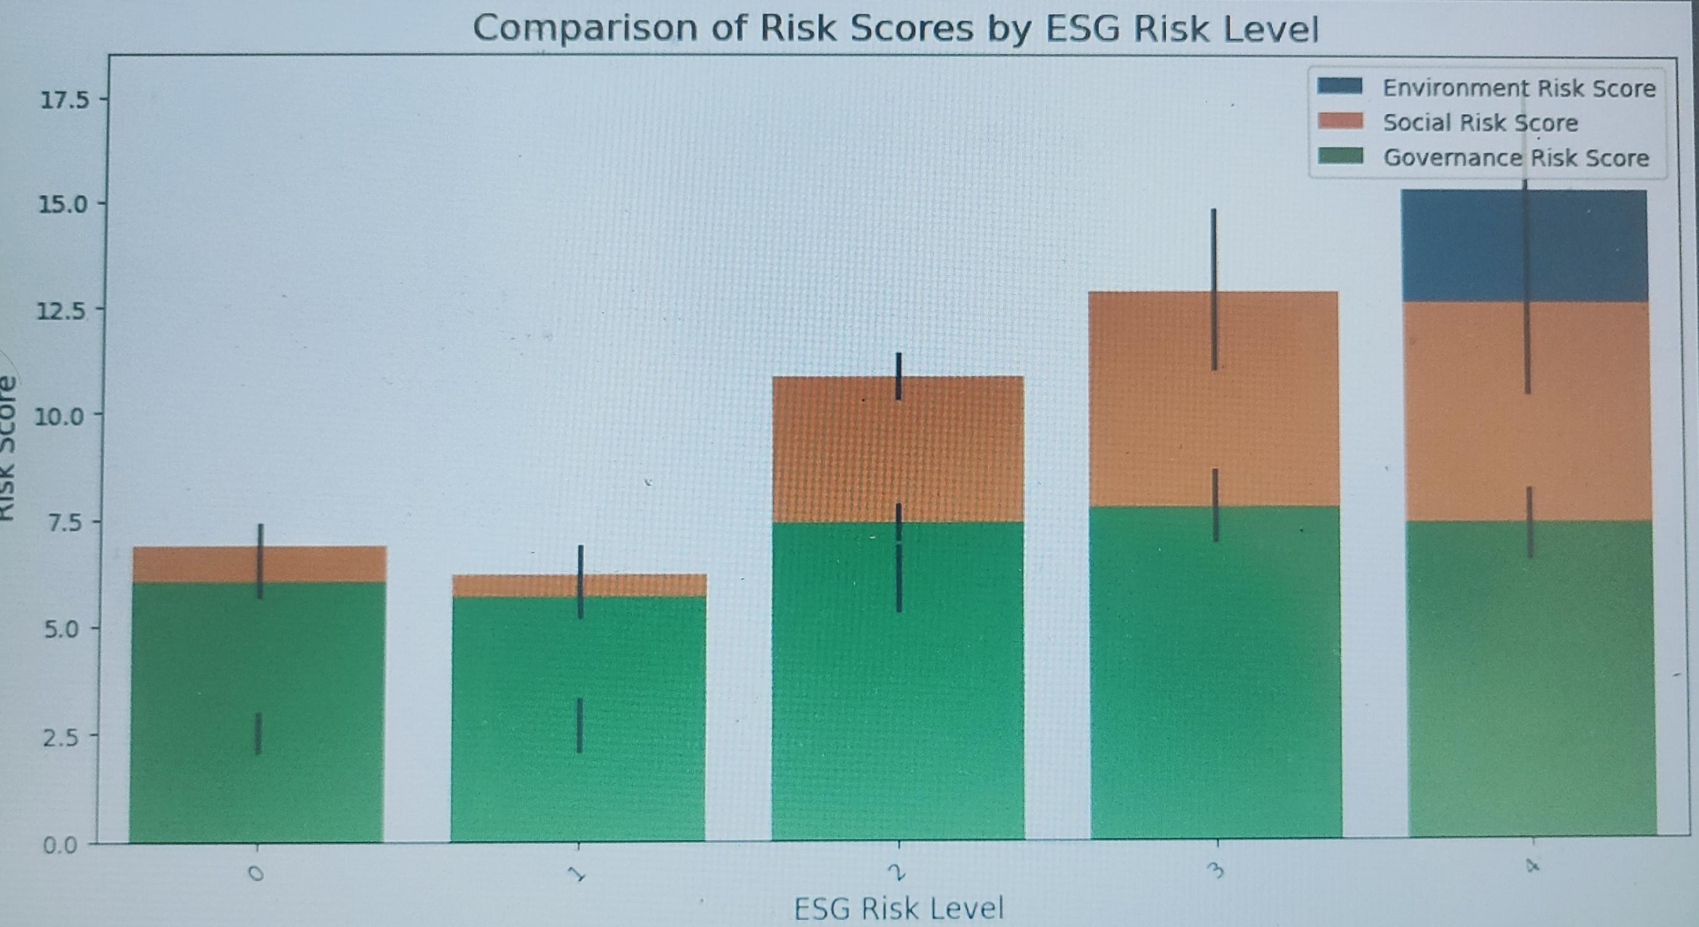
Data Visualization
Comparison between the risk scores by risk level

Slide 8
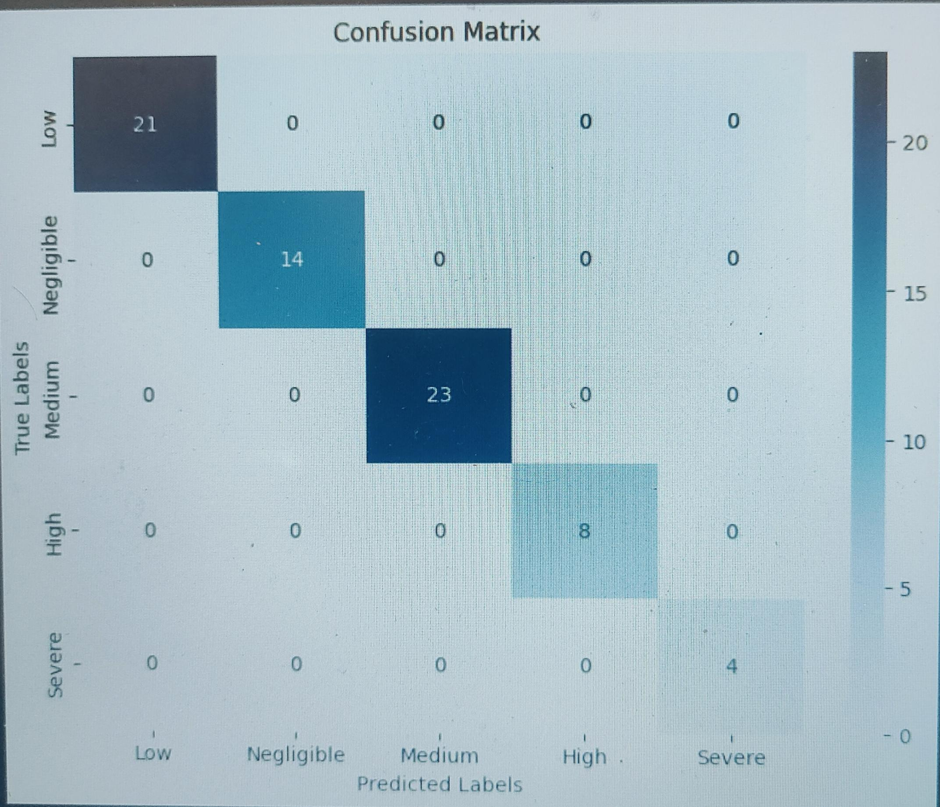
Confusion matrix

Slide 9
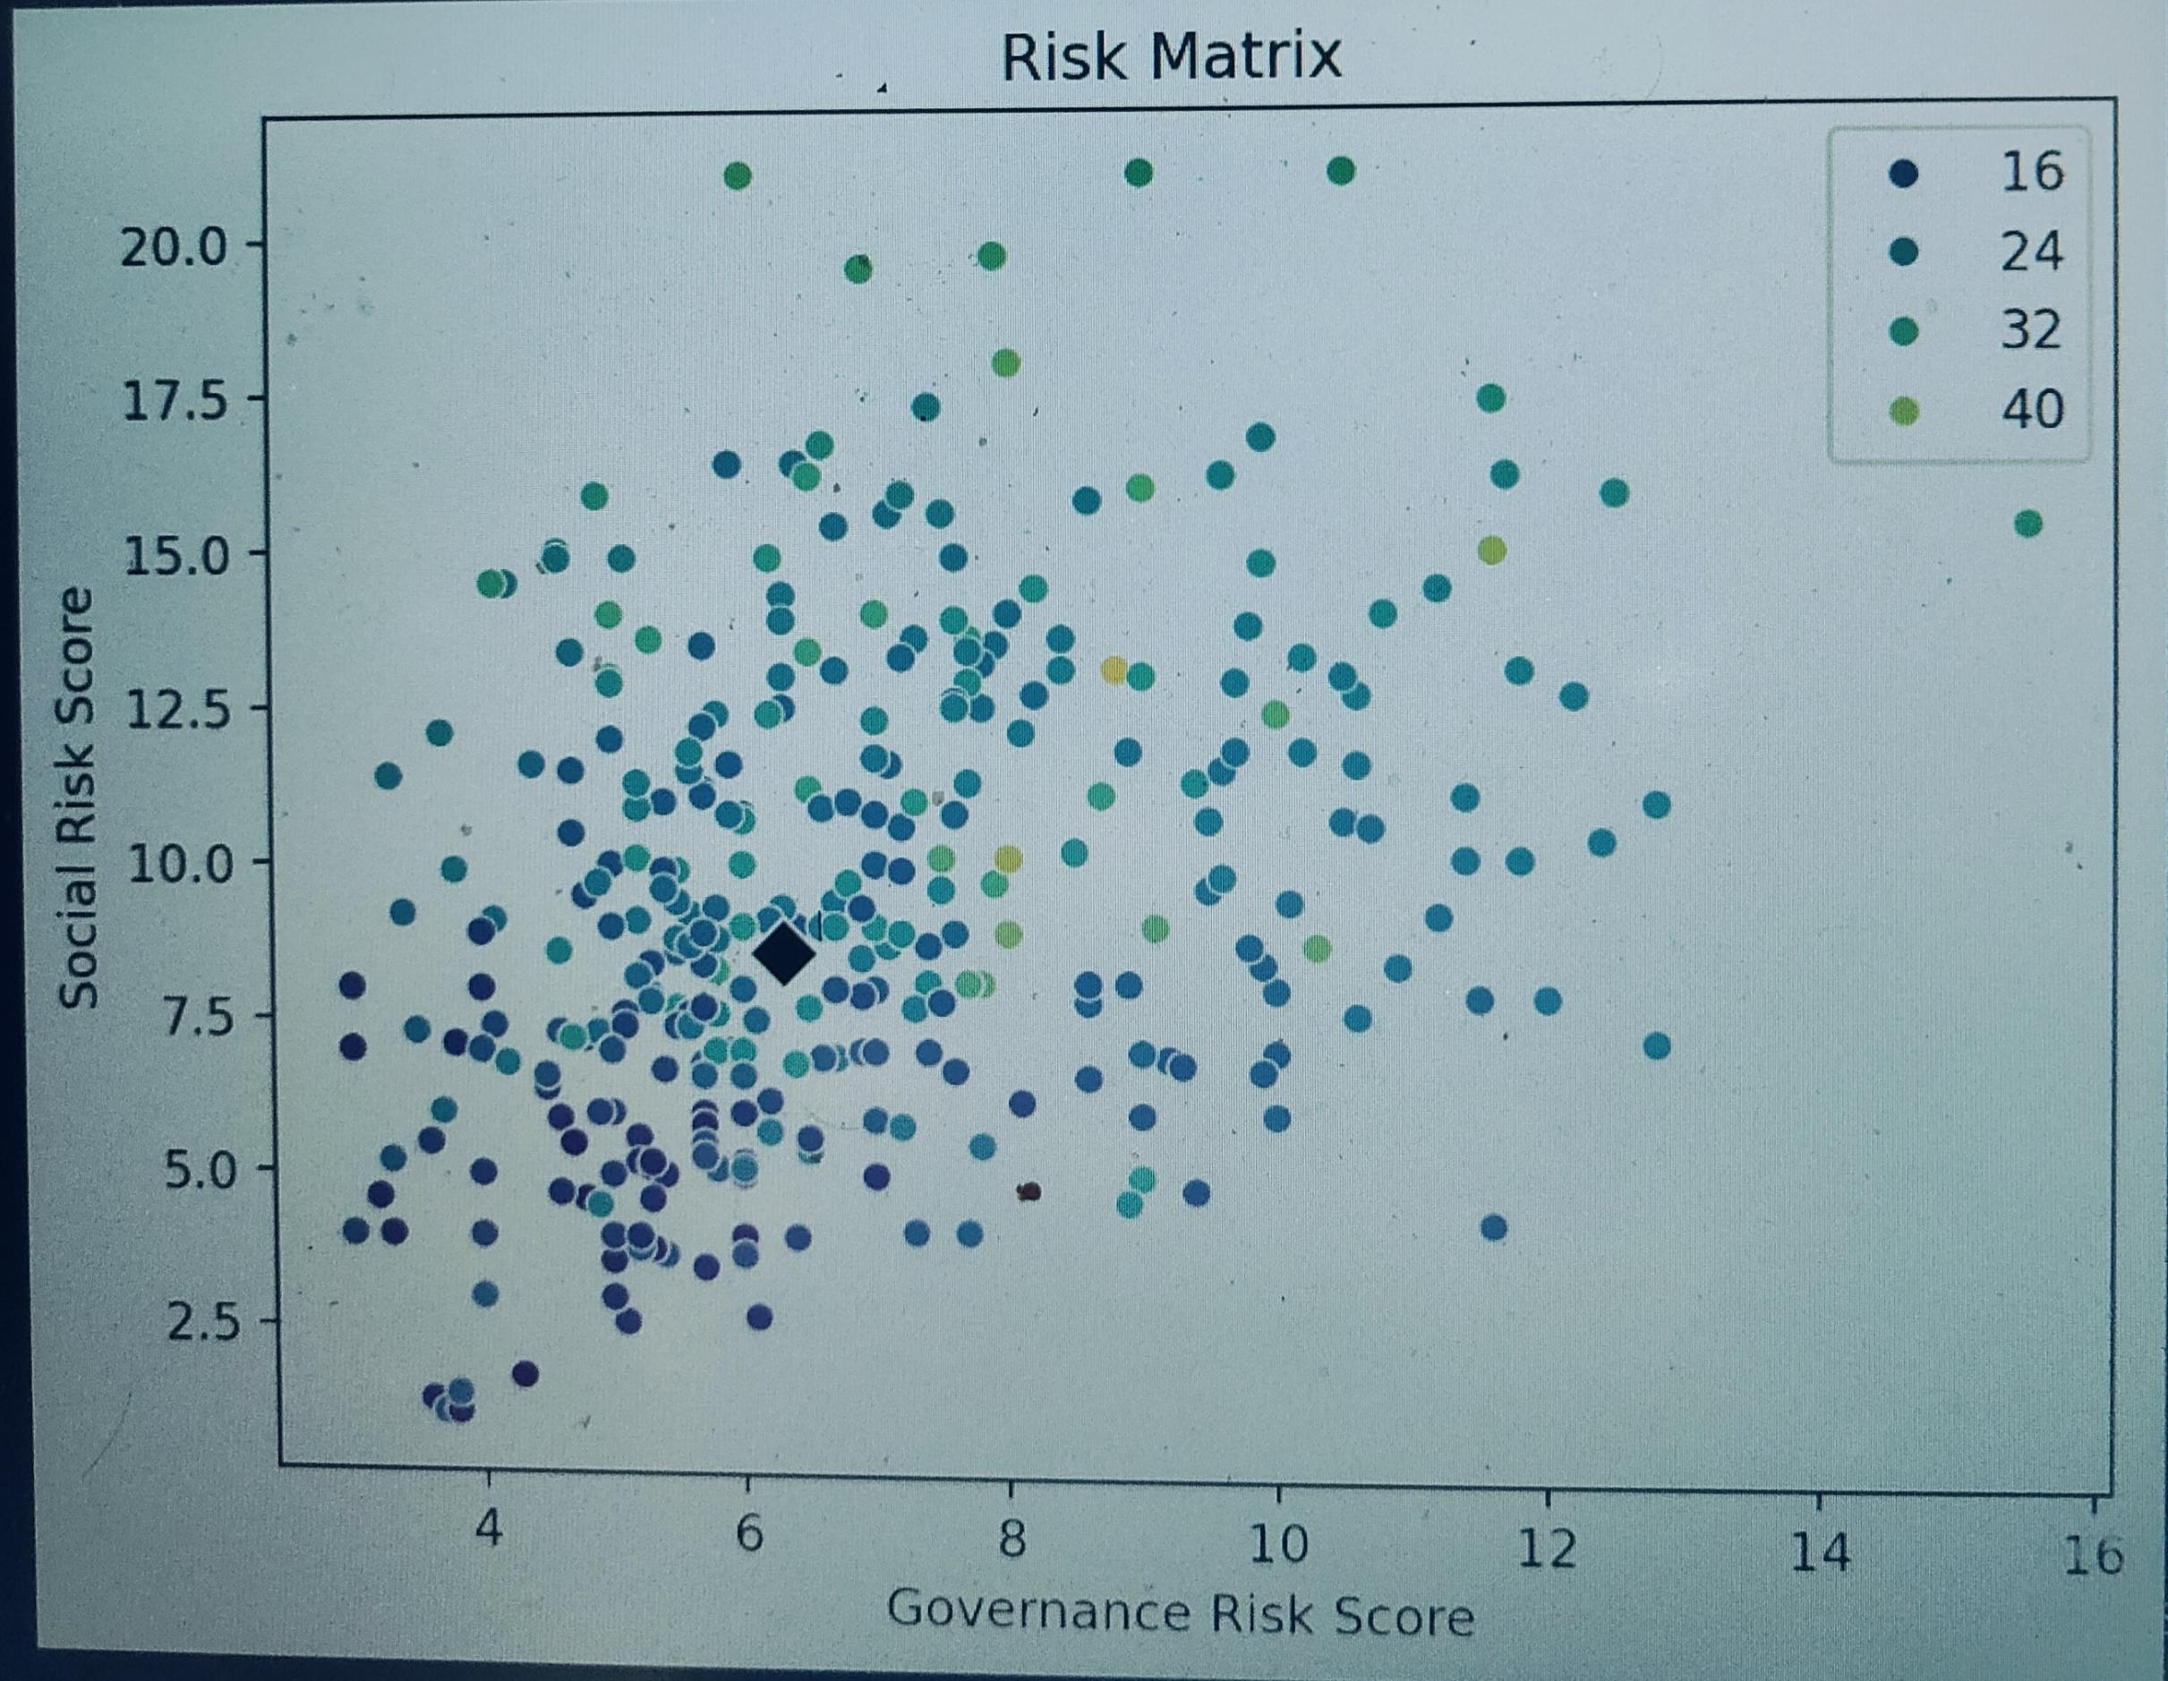
Risk Matrix

Slide 10
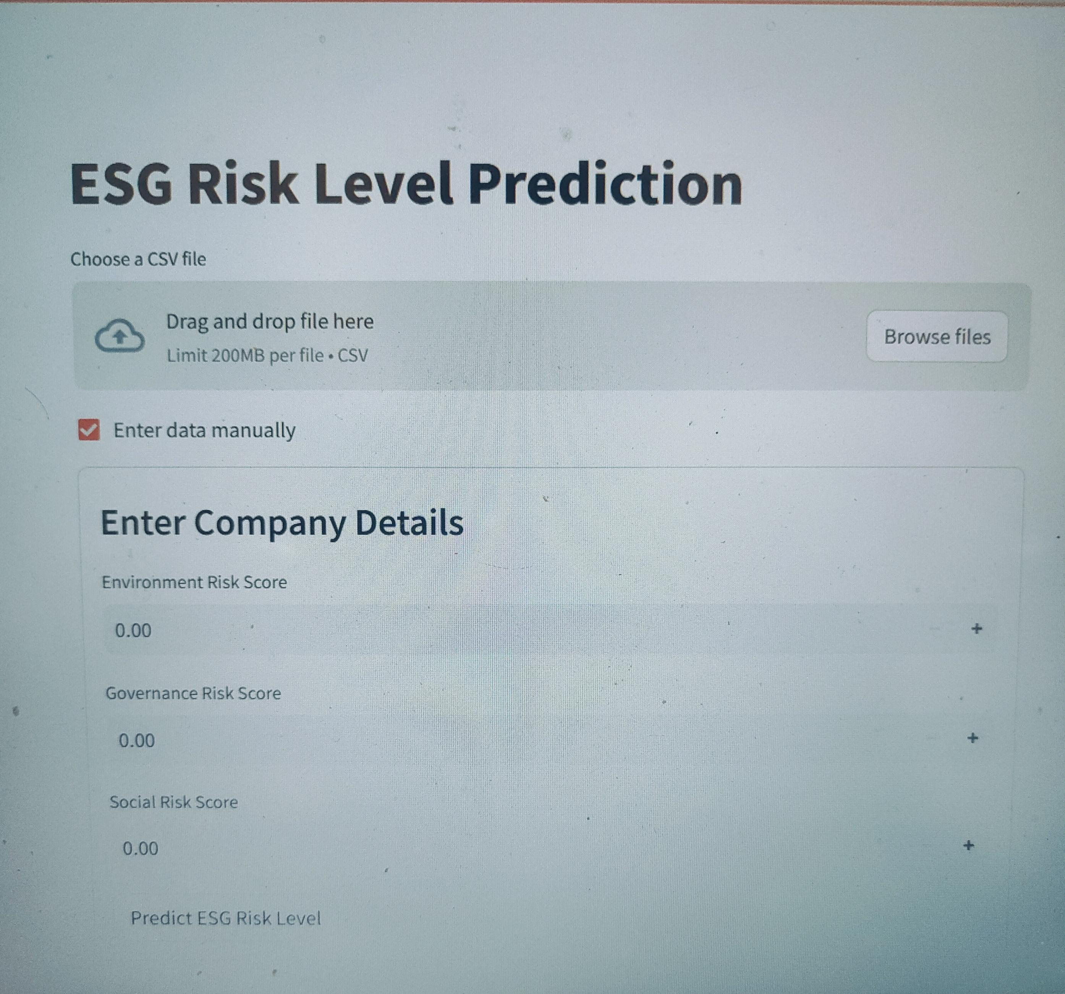
Streamlit:

Slide 11
THANK YOU

